Slide 1
What is Anomaly Detection?

Slide 2
What is Anomaly Detection?
In data analysis,
Notes:
In data analysis, anomaly detection is the identification of rare items, events or observations which raise suspicions by differing significantly from the majority of the data.

Slide 3
What is Anomaly Detection?
In data analysis, anomaly detection
Notes:
In data analysis, anomaly detection is the identification of rare items, events or observations which raise suspicions by differing significantly from the majority of the data.

Slide 4
What is Anomaly Detection?
In data analysis, anomaly detection is the identification of rare items, events or observations
Notes:
In data analysis, anomaly detection is the identification of rare items, events or observations which raise suspicions by differing significantly from the majority of the data.

Slide 5
What is Anomaly Detection?
In data analysis, anomaly detection is the identification of rare items, events or observations which raise suspicions
Notes:
In data analysis, anomaly detection is the identification of rare items, events or observations which raise suspicions by differing significantly from the majority of the data.

Slide 6
What is Anomaly Detection?
In data analysis, anomaly detection is the identification of rare items, events or observations which raise suspicions because they differing significantly
Notes:
In data analysis, anomaly detection is the identification of rare items, events or observations which raise suspicions by differing significantly from the majority of the data.

Slide 7
What is Anomaly Detection?
In data analysis, anomaly detection is the identification of rare items, events or observations which raise suspicions because they differing significantly from the majority of the data.
Notes:
In data analysis, anomaly detection is the identification of rare items, events or observations which raise suspicions by differing significantly from the majority of the data.

Slide 8
Outlier

Slide 9



Multiple Application Domains
Health
Industry
Security
Notes:
Shield: https://thenounproject.com/search/?q=security&i=1281469
https://thenounproject.com/search/?q=industry&i=3321404
Heart: https://thenounproject.com/search/?q=health&i=2915271

Slide 10
Multiple Sensors
Health
Industry
Security
ECG Sensor
Accelerometer
IR Motion Sensor
Notes:
Shield: https://thenounproject.com/search/?q=security&i=1281469
https://thenounproject.com/search/?q=industry&i=3321404
Heart: https://thenounproject.com/search/?q=health&i=2915271

Slide 11
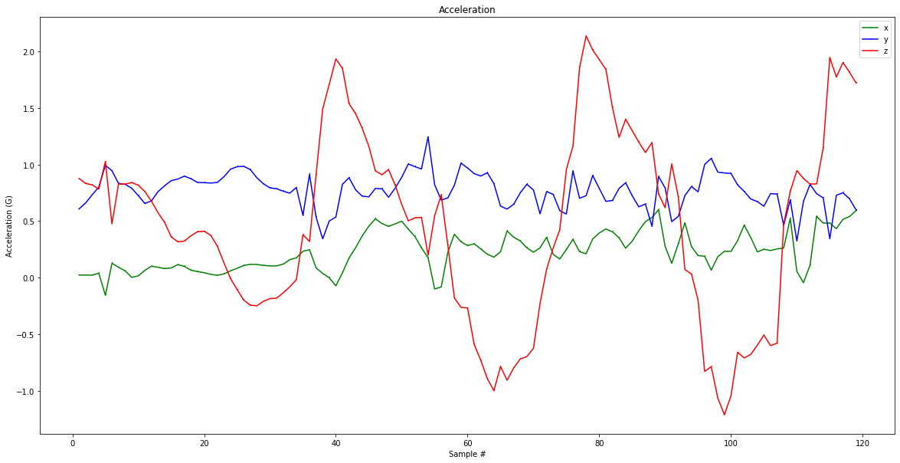
Multiple Sensors
Notes:
What do all of these applications have in common? Time series data is a sequence of measurements where the temporal relationship is a critical component to understanding the data.
Graph by Colby (prof-owned)

Slide 12
Multiple Sensors
Notes:
What do all of these applications have in common? Time series data is a sequence of measurements where the temporal relationship is a critical component to understanding the data.
Graph by Colby (prof-owned)

Slide 13
Multiple Sensors
?
Notes:
What do all of these applications have in common? Time series data is a sequence of measurements where the temporal relationship is a critical component to understanding the data.
Graph by Colby (prof-owned)

Slide 14
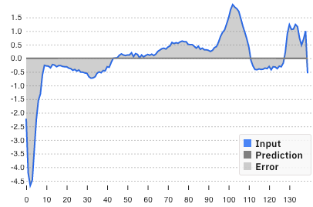
Three Fundamental Aspects of AD
Input
Notes:
MIT liscenece shoudl be good https://github.com/victordibia/anomagram/blob/master/LICENSE
Graph Screenshots from https://anomagram.fastforwardlabs.com/#/

Slide 15
Three Fundamental Aspects of AD
Input
Prediction
Notes:
MIT liscenece shoudl be good https://github.com/victordibia/anomagram/blob/master/LICENSE
Graph Screenshots from https://anomagram.fastforwardlabs.com/#/

Slide 16
Three Fundamental Aspects of AD
Input
Prediction
Error
Notes:
MIT liscenece shoudl be good https://github.com/victordibia/anomagram/blob/master/LICENSE
Graph Screenshots from https://anomagram.fastforwardlabs.com/#/

Slide 17

Poor Prediction

Slide 18
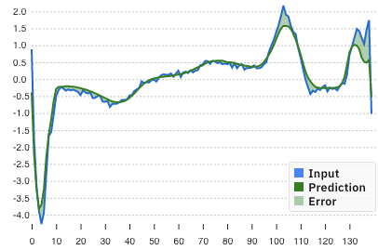
Poor Prediction
Good Prediction

Slide 19



Why TinyML?
Notes:
Why is tinyML critical for this application space?
Too much data to stream or bad/spotty connections
Need to act quickly
Need to conserve battery life

Slide 20
Machine Learning
Notes:
Unlike with some of the other applications we’ve covered, traditional ML methods are still popular for anomaly detection. In this section we will explore a more traditional clustering approach as well as a deep neural network approach.
We are only looking at a few approaches.
K-means and autoencoders

Slide 21


Machine Learning
Collect
Data
Preprocess
Data
Design a
Model
Train a
Model
Evaluate
Optimize
Convert
Model
Deploy
Model
Make
Inferences
Micro
Notes:
Unlike with some of the other applications we’ve covered, traditional ML methods are still popular for anomaly detection. In this section we will explore a more traditional clustering approach as well as a deep neural network approach.
We are only looking at a few approaches.
K-means and autoencoders

Slide 22
It’s not all deep learning
Machine Learning
Classification
Nearest Neighbor
Clustering
Notes:
Unlike with some of the other applications we’ve covered, traditional ML methods are still popular for anomaly detection. In this section we will explore a more traditional clustering approach as well as a deep neural network approach.
We are only looking at a few approaches.
K-means and autoencoders

Slide 23
It’s not all deep learning
Machine Learning
Classification
Nearest Neighbor
Clustering
Neural Networks
Notes:
Unlike with some of the other applications we’ve covered, traditional ML methods are still popular for anomaly detection. In this section we will explore a more traditional clustering approach as well as a deep neural network approach.
We are only looking at a few approaches.
K-means and autoencoders

Slide 24
It’s not all deep learning
Machine Learning
Classification
Nearest Neighbor
Clustering
Neural Networks
SVM
Notes:
Unlike with some of the other applications we’ve covered, traditional ML methods are still popular for anomaly detection. In this section we will explore a more traditional clustering approach as well as a deep neural network approach.
We are only looking at a few approaches.
K-means and autoencoders

Slide 25
It’s not all deep learning
Machine Learning
Classification
Nearest Neighbor
Clustering
Neural Networks
SVM
...
KNN
...
K-Means
...
Notes:
Unlike with some of the other applications we’ve covered, traditional ML methods are still popular for anomaly detection. In this section we will explore a more traditional clustering approach as well as a deep neural network approach.
We are only looking at a few approaches.
K-means and autoencoders

Slide 26
It’s not all deep learning
Machine Learning
Classification
Nearest Neighbor
Clustering
Neural Networks
SVM
...
KNN
...
K-Means
...
Notes:
Unlike with some of the other applications we’ve covered, traditional ML methods are still popular for anomaly detection. In this section we will explore a more traditional clustering approach as well as a deep neural network approach.
We are only looking at a few approaches.
K-means and autoencoders

Slide 27
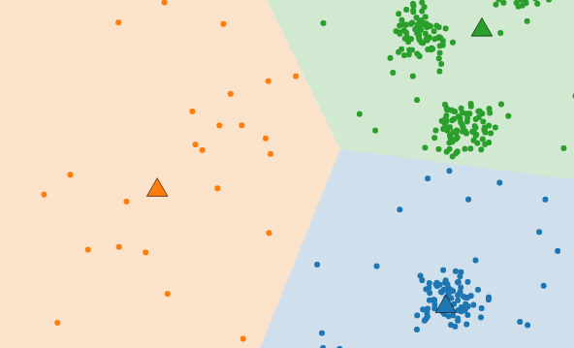
It’s not all deep learning
Machine Learning
Classification
Nearest Neighbor
Clustering
Neural Networks
SVM
...
KNN
...
K-Means
...
Notes:
Unlike with some of the other applications we’ve covered, traditional ML methods are still popular for anomaly detection. In this section we will explore a more traditional clustering approach as well as a deep neural network approach.
We are only looking at a few approaches.
K-means and autoencoders
One of the most straightforward tasks we can perform on a data set without labels is to find groups of data in our dataset which are similar to one another -- what we call clusters.

Slide 28
It’s not all deep learning
Machine Learning
Classification
Nearest Neighbor
Clustering
Neural Networks
SVM
...
KNN
...
K-Means
...
Autoencoders
Notes:
Unlike with some of the other applications we’ve covered, traditional ML methods are still popular for anomaly detection. In this section we will explore a more traditional clustering approach as well as a deep neural network approach.
We are only looking at a few approaches.
K-means and autoencoders

Slide 29



What are we going to learn?
Collect and Preprocess Data
Design
and Train
Model
Evaluate, Optimize, Convert, Deploy
Make
Inferences
Micro
Challenges with an Anomaly Detection Application
Anomaly Detection ML Pipeline
Training, Testing
in Colab
Notes:
Challenges = Bandwidth, Battery, Latency, Accuracy, Datasets
The AD ML Pipeline = Real World case studies of how to anomaly detection implemented in industry
Hands-on training and of anomaly detection models in Colab!

